Slide 1
Nonlinear Dynamical Systems Workshop
Friday Morning

Slide 2
Overview (8:30)
Questions?
Entropy
Catastrophe redux
Panel Data & Network Analysis
Topological Data Analysis
Phases and Markov Matrices

Slide 3
Entropy Example
Data from Ricca et al. (2020) – NDSMacro1, etc.
devtools::install_github(“barneyricca/NDSEntropy”)
library(NDSEntropy)
win_ent(pull(read_csv("http://bit.ly/NDSMacro1")),5)

Slide 4
Entropy CYO
Try this with NDSMacro1, NDSMacro2, NDSMacro3, and NDSMacro4
Don’t worry about appropriate window size; try 5
Try other window sizes if you wish, too.
Discussion: How do we know which identified transition points are correct?
Discussion: Should we create entropy from distribution of state data or from distribution of dynamics data (a la transition matrix)?

Slide 5
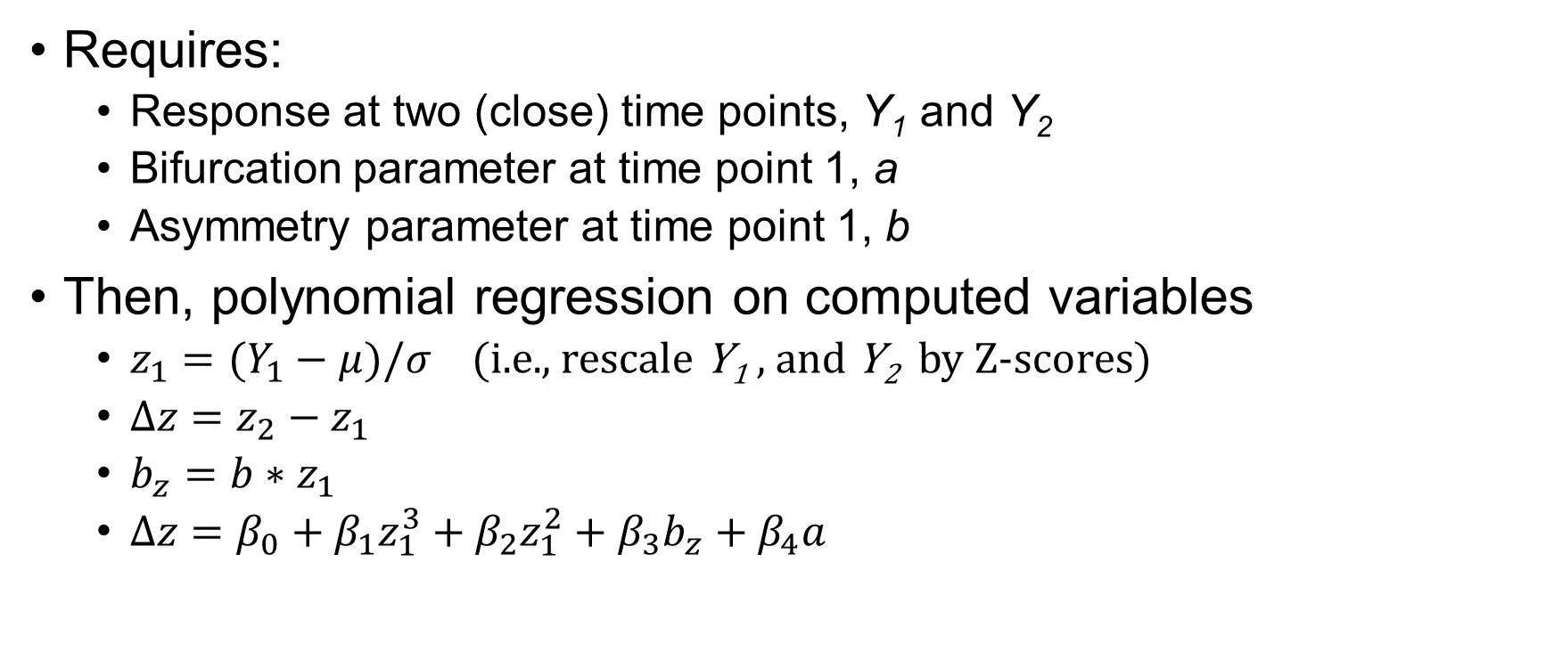
Cusp Redux: Polynomial Regression
Requires:
Response at two (close) time points, Y₁ and Y₂
Bifurcation parameter at time point 1, a
Asymmetry parameter at time point 1, b
Then, polynomial regression on computed variables
$z_{1}=(Y_{1}−μ)/σ$ (i.e., rescale Y₁ , and Y₂ by Z-scores)
$∆z=z_{2}−z_{1}$
$b_{z}=b∗z_{1}$
$∆z=β_{0}+β_{1}z_{1}^{3}+β_{2}z_{1}^{2}+β_{3}b_{z}+β_{4}a$

Slide 6
Cusp Example
Chen et al. (2014) results
Everything except Cardan’s determinant
Residual analysis!

Slide 7
Swallowtail Example
Guastello et al. (2018)

Slide 8
Butterfly Example
Guastello (1985) on student performance
a (first asymmetry)
b (first bifurcation)
c (swallowtail, second asymmetry)
d (butterfly, second bifurcation)
Response: 3 stable levels
a determines bottom v. top two
b determines top v. bottom two

Slide 9
Figuring it Out: Catastrophes
Start with a theoretical moderator variable
How do you usually identify a moderator?
Is this a variable that predicts a second (response) variable by itself?
Think about the second (response) variable that has logistic behavior based on a third (asymmetry) variable
Is there hysteresis?
What causes the stuck-ness?
There’s a catastrophe!

Slide 10
Break (10:00)
We’ll start back up at 10:15

Slide 11
Panel Data
With individual time series variables, there are two types of co-variations
Within a single subject across time (auto regression, or lagged correlations)
Across subjects within a single time (correlation)
Which of these would you want under what research questions?

Slide 12
Panel Data
Now consider EMA-type data: MANY co-variations
Lagged correlation of item within a subject across time
Correlation of item with item within a subject within time
Lagged correlation of item with item within a subject
Correlation of item within time across subjects
Lagged cross-panel models, etc.
What do each of these mean?
E.g., what research question would they be appropriate for?

Slide 13
Networks and Panel Data
Greene et al., (2018)
Contemporaneous Networks
Temporal Networks
Between Networks
NDSPanel
Simulated depression data for 1000 people
NDSEMA
EMA data for wildfire survivors
How to make your statistician happy
Sorry…some data cleaning required here, so there’s extra R

Slide 14
Network Analyses
Plotting with qgraph
Quadratic Assignment Procedure (QAP)
Bootstrap inference
Works with matrices, too!
Communities
Bridges

Slide 15
Markov revisited
What is a “phase”?
Compare matrices (or networks)
Statistically different matrices can indicate different phases
Recall: Markov matrices are proxies for the dynamics

Slide 16
Lunch (11:30)
We’ll start back up at 1:30

Slide 17
Topological Data Analysis

Slide 18
Topology
Really, topology is about transformations
Geometry: properties that are preserved under rotations, translations, and reflections
Topology: properties that are preserved under homology
Huh?!
Stretch, twist, deform, bend, move, etc., but not cut or glue or tie, etc.
We’ll do a simplified approach to topology and homology
Avoid simplexes, filtrations, Ripf vs. Cech, etc.,
Instead, we’ll rely on examples and generalize from there
Will almost certainly be correct for real-world data that are encountered in psychology, economics, etc.
But be careful

Slide 19
Three important concepts
Betti numbers
Coverings
Level sets
Identifying features & regions
Persistence: How to use the previous two with data
Persistence Diagrams
The workhorse
Bottleneck distances
Persistence landscapes
And RQA on persistence landscapes (Zhang, et al., 2020)
Notes:
Sadly, “level sets” is also used with time series, but in another context. Sigh.

Slide 20
Betti numbers
Give the number of different types of features that an object possesses
Features: Objects and holes
Objects (0-d holes) – β₀
Circles (1-d holes) – β₁
Balloons (2-d holes) – β₂
and more, in higher dimensions
Embedding
An example may help

Slide 21
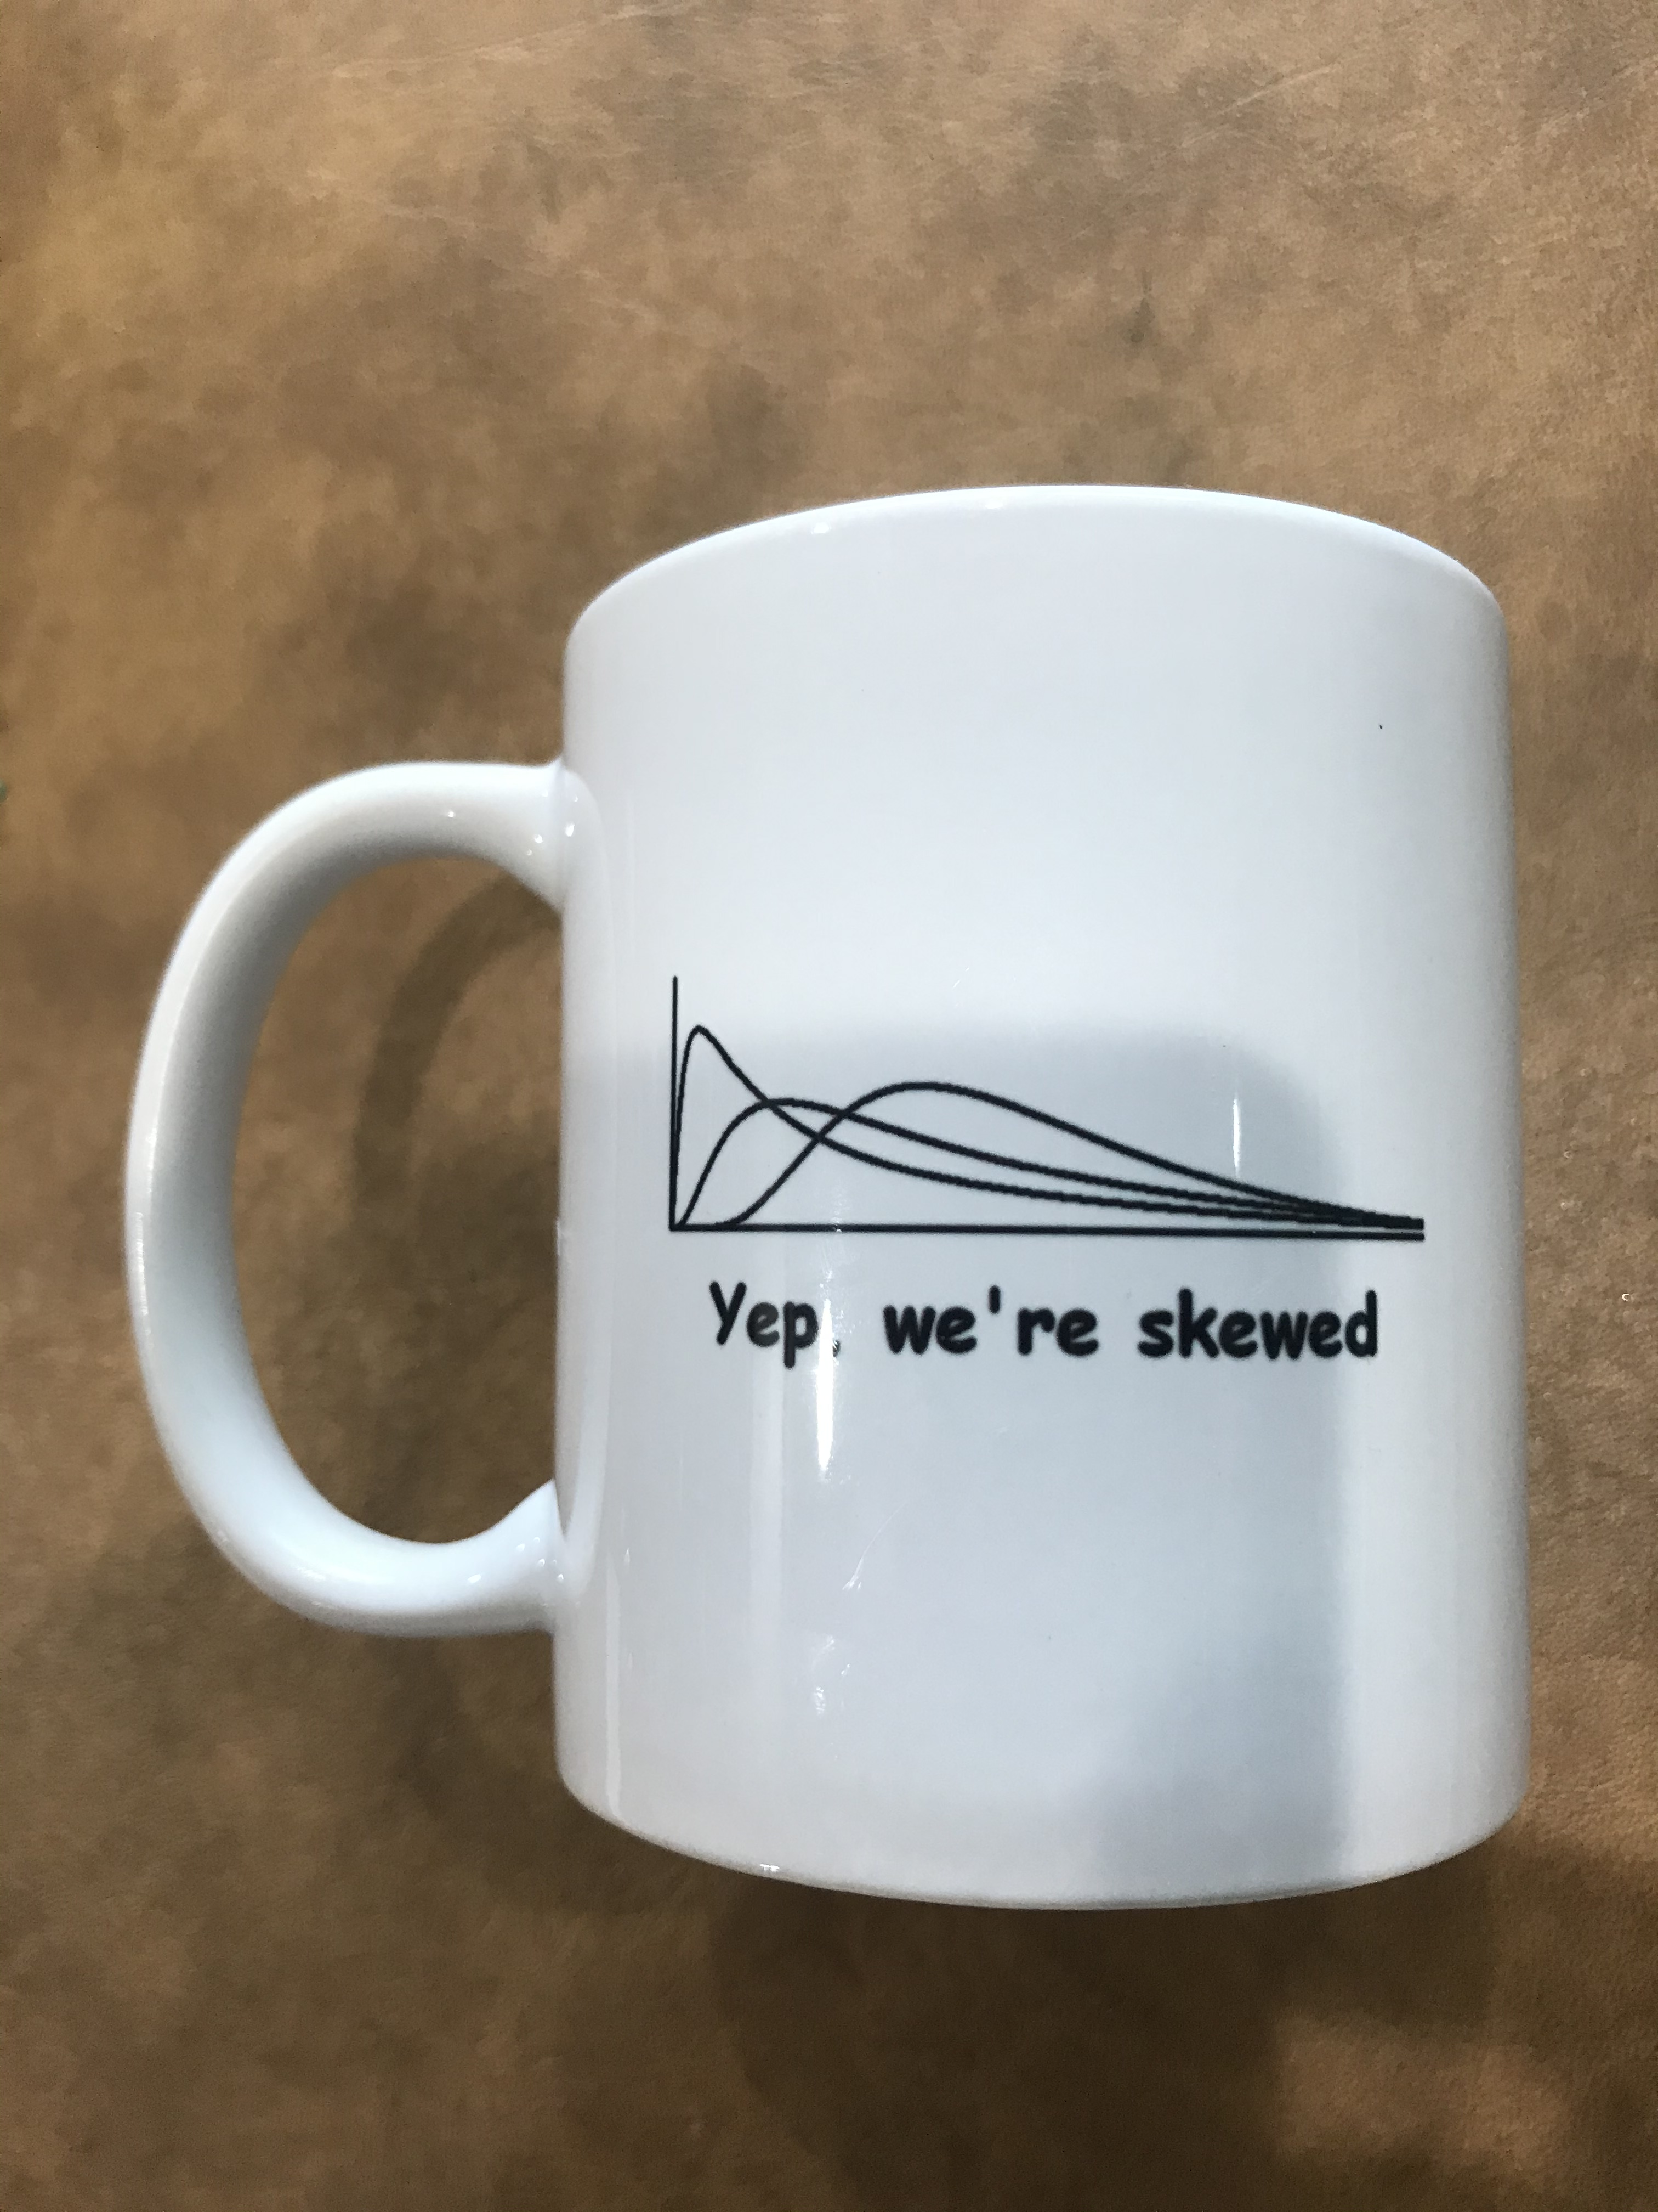
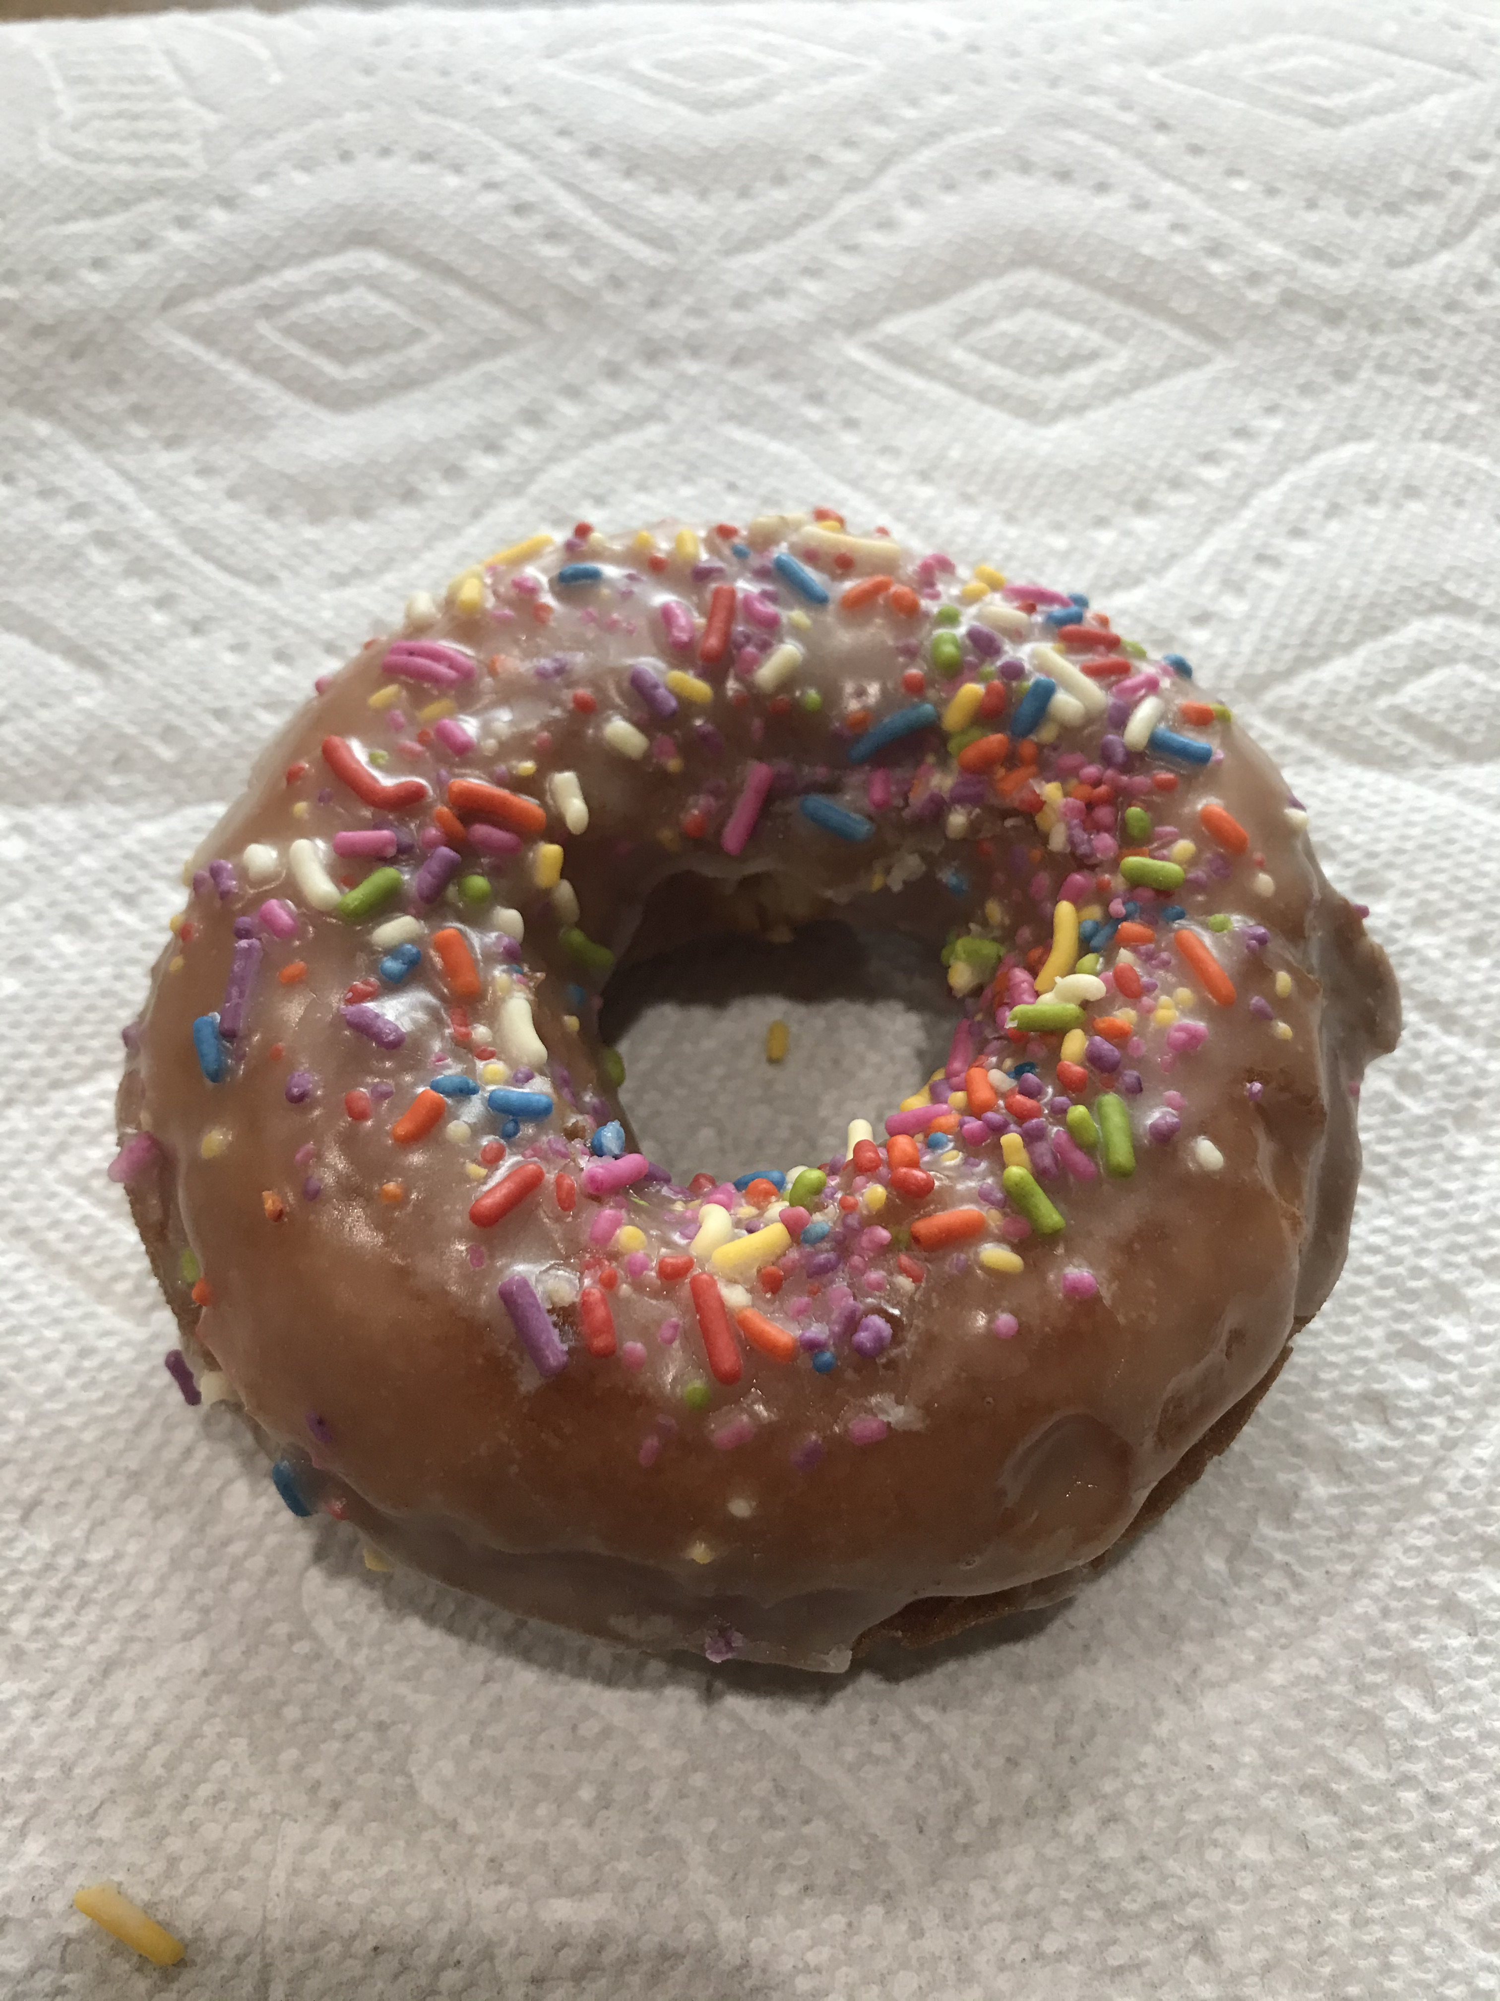
A donut and a coffee cup
Each of these is:
1 object

Slide 22
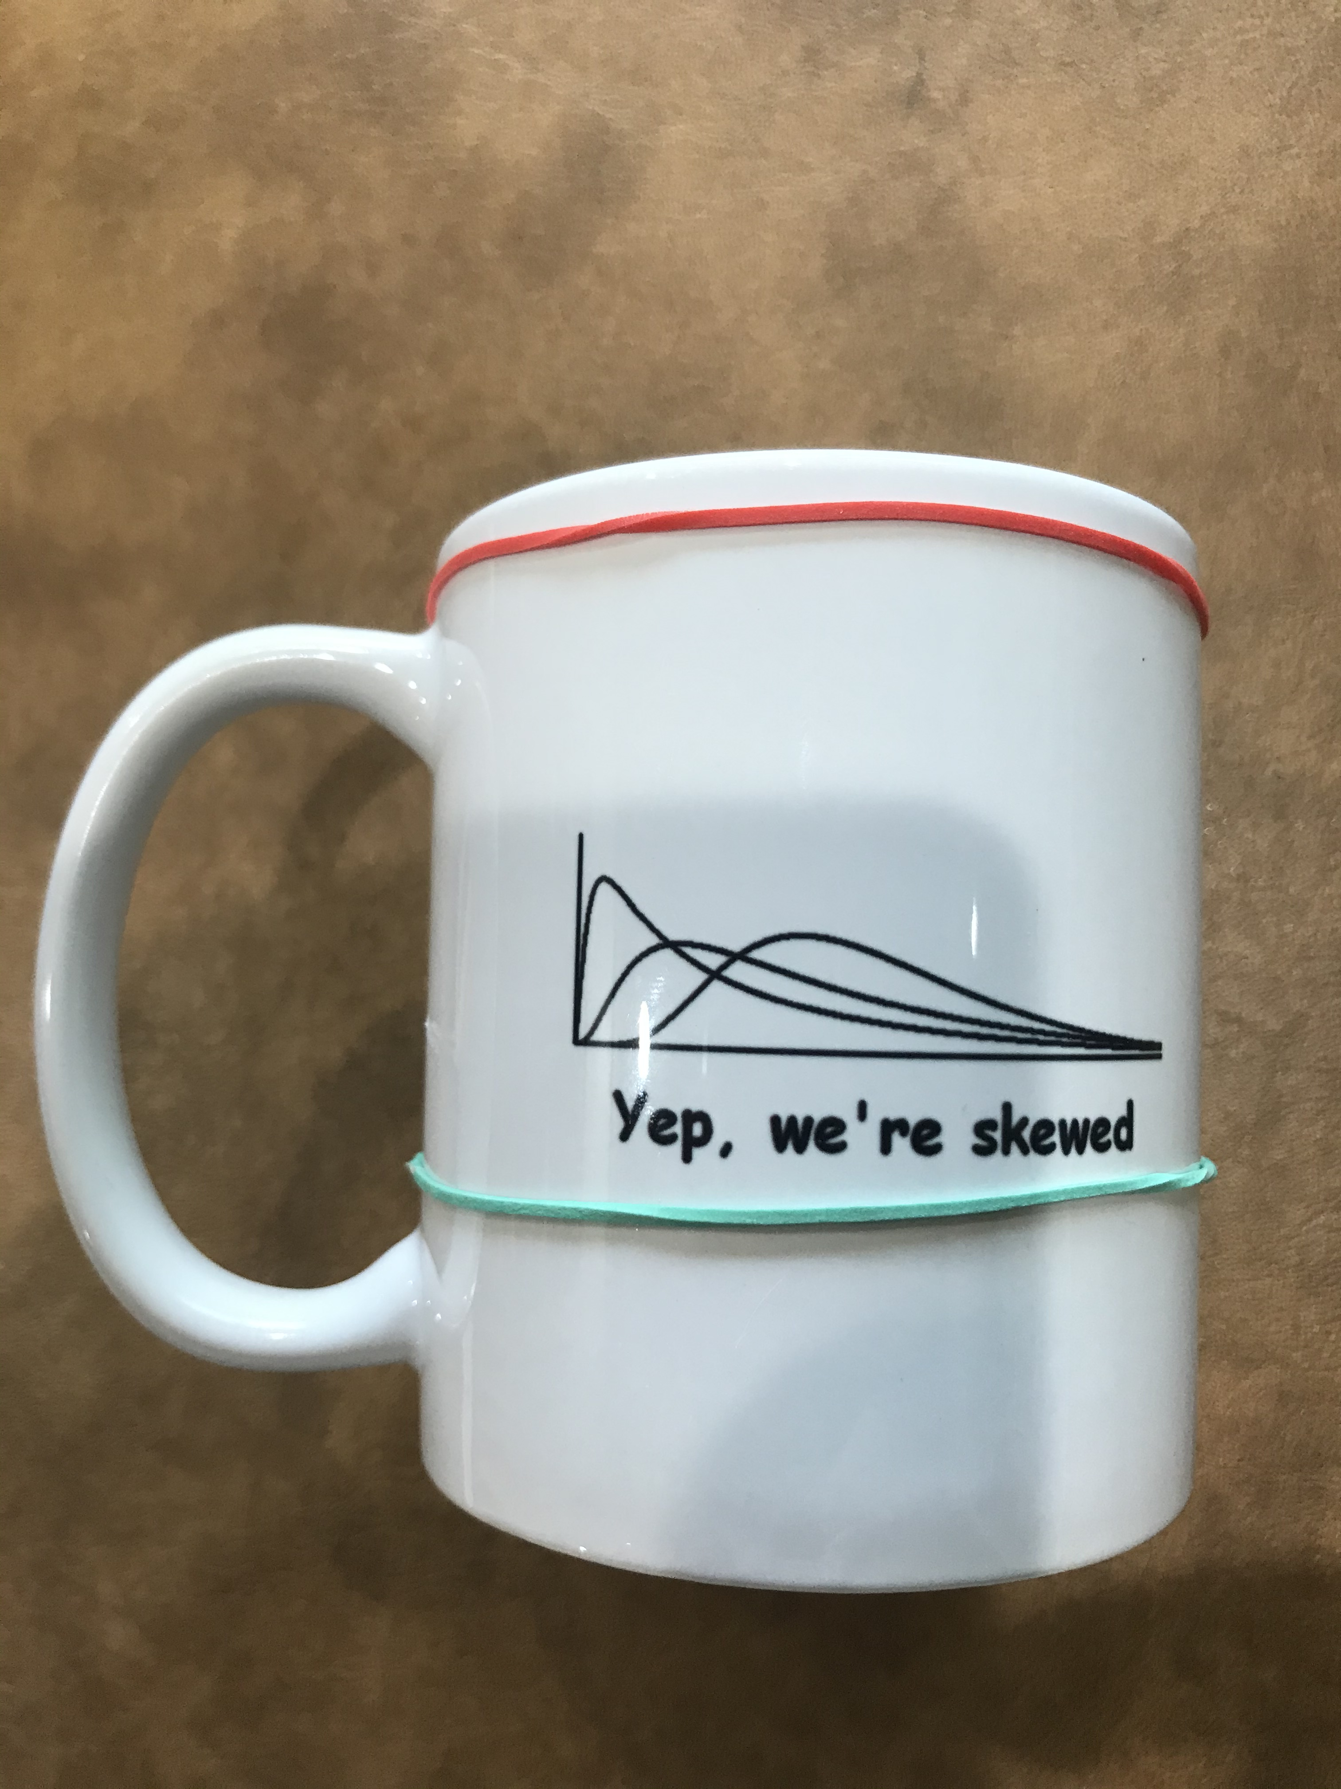
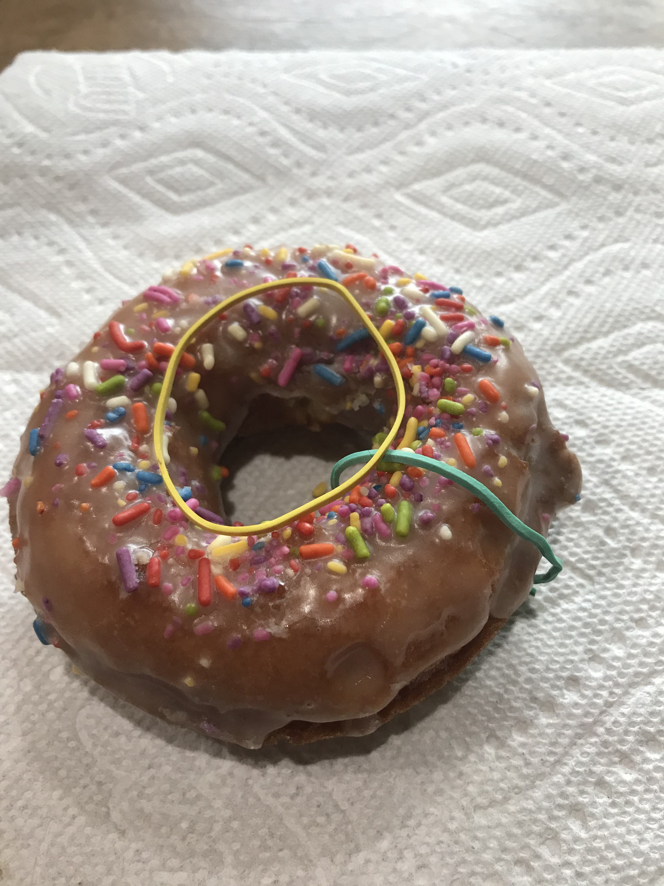
A donut and a coffee cup
Each of these is:
1 object
2 different circles
Notes:
Try moving one rubber band to the other without cutting either the rubber band or the donut/cup

Slide 23
A donut and a coffee cup
Each of these is:
1 object
2 different circles
1 balloon will surround them
Notes:
Try moving one rubber band to the other without cutting either the rubber band or the donut/cup

Slide 24
A donut and a coffee cup
Each of these is:
1 object (𝛃₀ = 1)
2 different circles (𝛃₁ = 2)
1 balloon (𝛃₂ = 1)
Therefore, they are the same (topologically)!
Notes:
So, the confusion is (to a topologist) understandable.

Slide 25
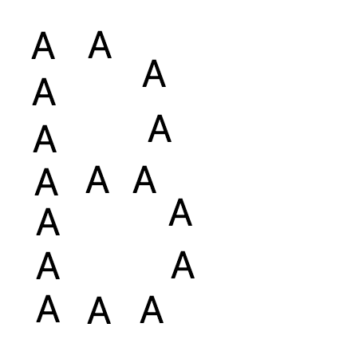
Betti Example
16 “A”s in 1 “B” shape
Initially, β₀ = 16, and β₁ = 16

Slide 26
Betti Example
Look at the coverings
Cover each data point (e.g., each pixel) with a ball of a small radius
Start with radius = 0
Radii change, and as they do, so do the number of objects and holes!
Let’s look at how each of the various “features” comes into existence (i.e., is born) or goes away (i.e., dies) as the radius of the balls increases

Slide 27
Persistent homology
Which features are important?
TDA can help us think about this
Identifies features that are persistent across a range of scales
Scales of what?
Scales of the objects themselves
I.e., As the objects are blurred (or as you zoom out) what features are the same across a large range of blurring/zooming?

Slide 28
Persistence diagrams
Plot the births and deaths of features on a two-dimensional graph
Horizontal axis: Birth scale
Vertical axis: Death scale
45º line for reference (can’t be born after you die!)
Helpfulness:
Further from the diagonal = better representative of system
Bootstrapped significance of features
Separate noise from signal!
Bottleneck distance
Measure of similarity for comparing two or more systems

Slide 29
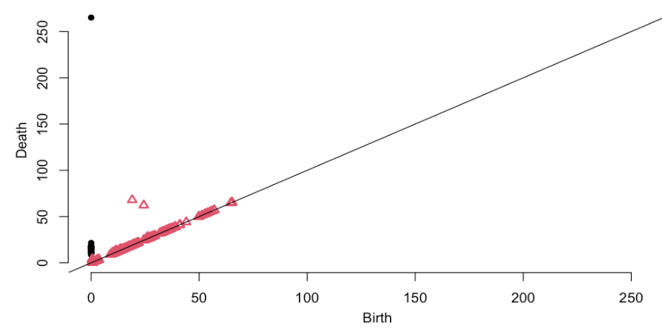
Persistence Diagram: A-B covering
Notes:
Notice the features not near the diagonal line:
The 2 holes in the B, and 1 object.
Most of the holes are born and die because they are bounded by 3 circles temporarily
16 of the holes are born at 0 and die at about 3.5 (the original holes)
Several thousand objects are born at 0 and die immediately; each ”pixel” is its own object.
16 of the objects are born at 0, and die later; 15 die from 10-20 pixels later, and one continues forever

Slide 30
A-B Features & Persistence
Objects
Holes

Slide 31
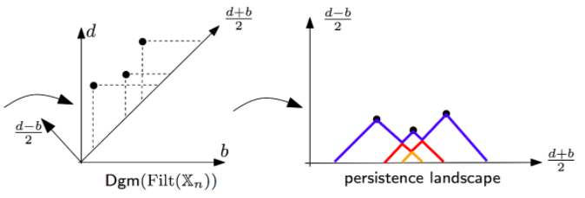
Persistence landscapes
Sort of a 45º clockwise rotation of the persistence diagram
Vertical lines up from the line birth = death to the features
Horizontal lines right from the feature to the line birth = death
Rotate
Notes:
http://bertrand.michel.perso.math.cnrs.fr/Enseignements/TDA/Tuto-Part4.html

Slide 32
Level sets
Draining a lake
Features: How many ponds? How many islands?
Really, topologists use levels that increase, not decrease, but the principle is the same
Rules
Joining and splitting
Newest feature dies first, as the water level falls

Slide 33
Landscape (or time series!)

Slide 34
Flooded: 0 features

Slide 35
One feature

Slide 36
Two features

Slide 37
Three features

Slide 38
Two features (2nd one died)

Slide 39
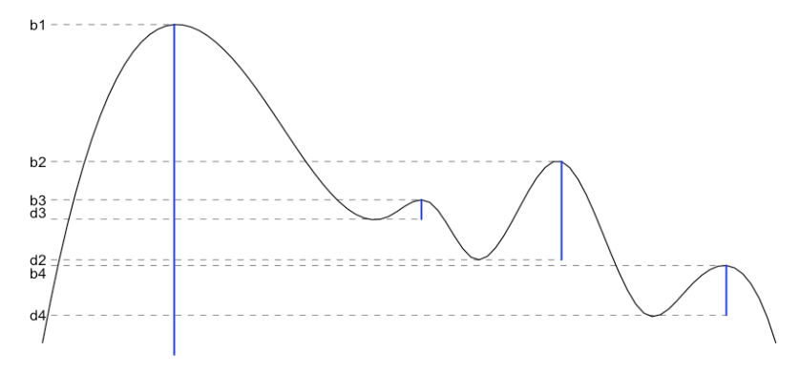
Final result: Births & deaths
Create a persistence diagram just as with coverings

Slide 40
Examples

Slide 41
Time Series: Learning to Walk
Early exploratory work I’m doing with Marybeth Grant-Buetler & Richard Buetler
We looked at these data before
Compare infants’ leg motions at different stages of development
Very noisy
TDA can help!
Let’s look at some plots

Slide 43
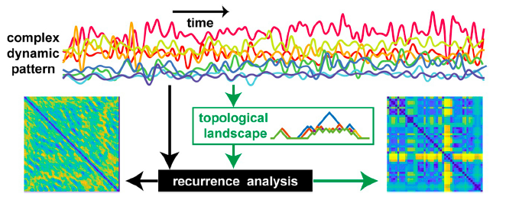
Multiple time series
Zhang et al. (2020). Topological portraits of multiscale coordination dynamics

Slide 44
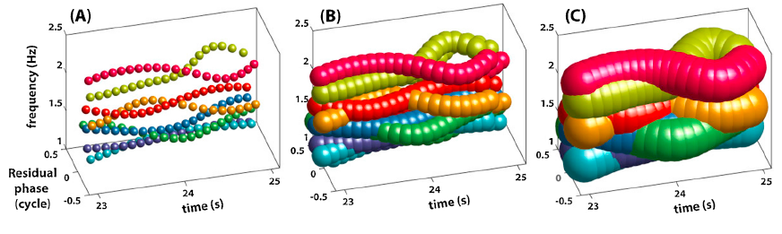
TDA -> RQA
Betti numbers -> Persistence landscape -> RQA

Slide 45
Workshop Evaluation
There’s a mini evaluation for the workshop. Your feedback would be appreciated ☺
http://bit.ly/NDSWorkshopSurvey
The GitHub site:
https://github.com/barneyricca/NDSWorkshop

